Slide 1


Slide 2
Helping Cineplex
With the rise of streaming platforms, it is becoming increasingly harder for cinemas such as Cineplex to remain competitive

Slide 3
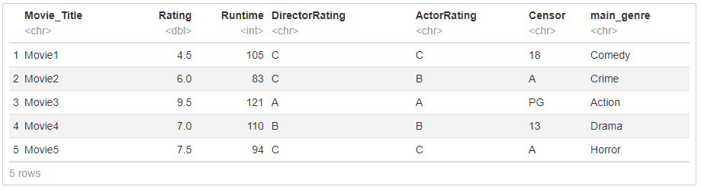
Which movie should Cineplex show?

Slide 4
JOURNEY MAP
Film production is completed
Buyers preview movies
Movie file is sent to buyers
01
03
05
02
04
Distributors setup movie screenings
Buyers and distributors negotiate terms

Slide 5
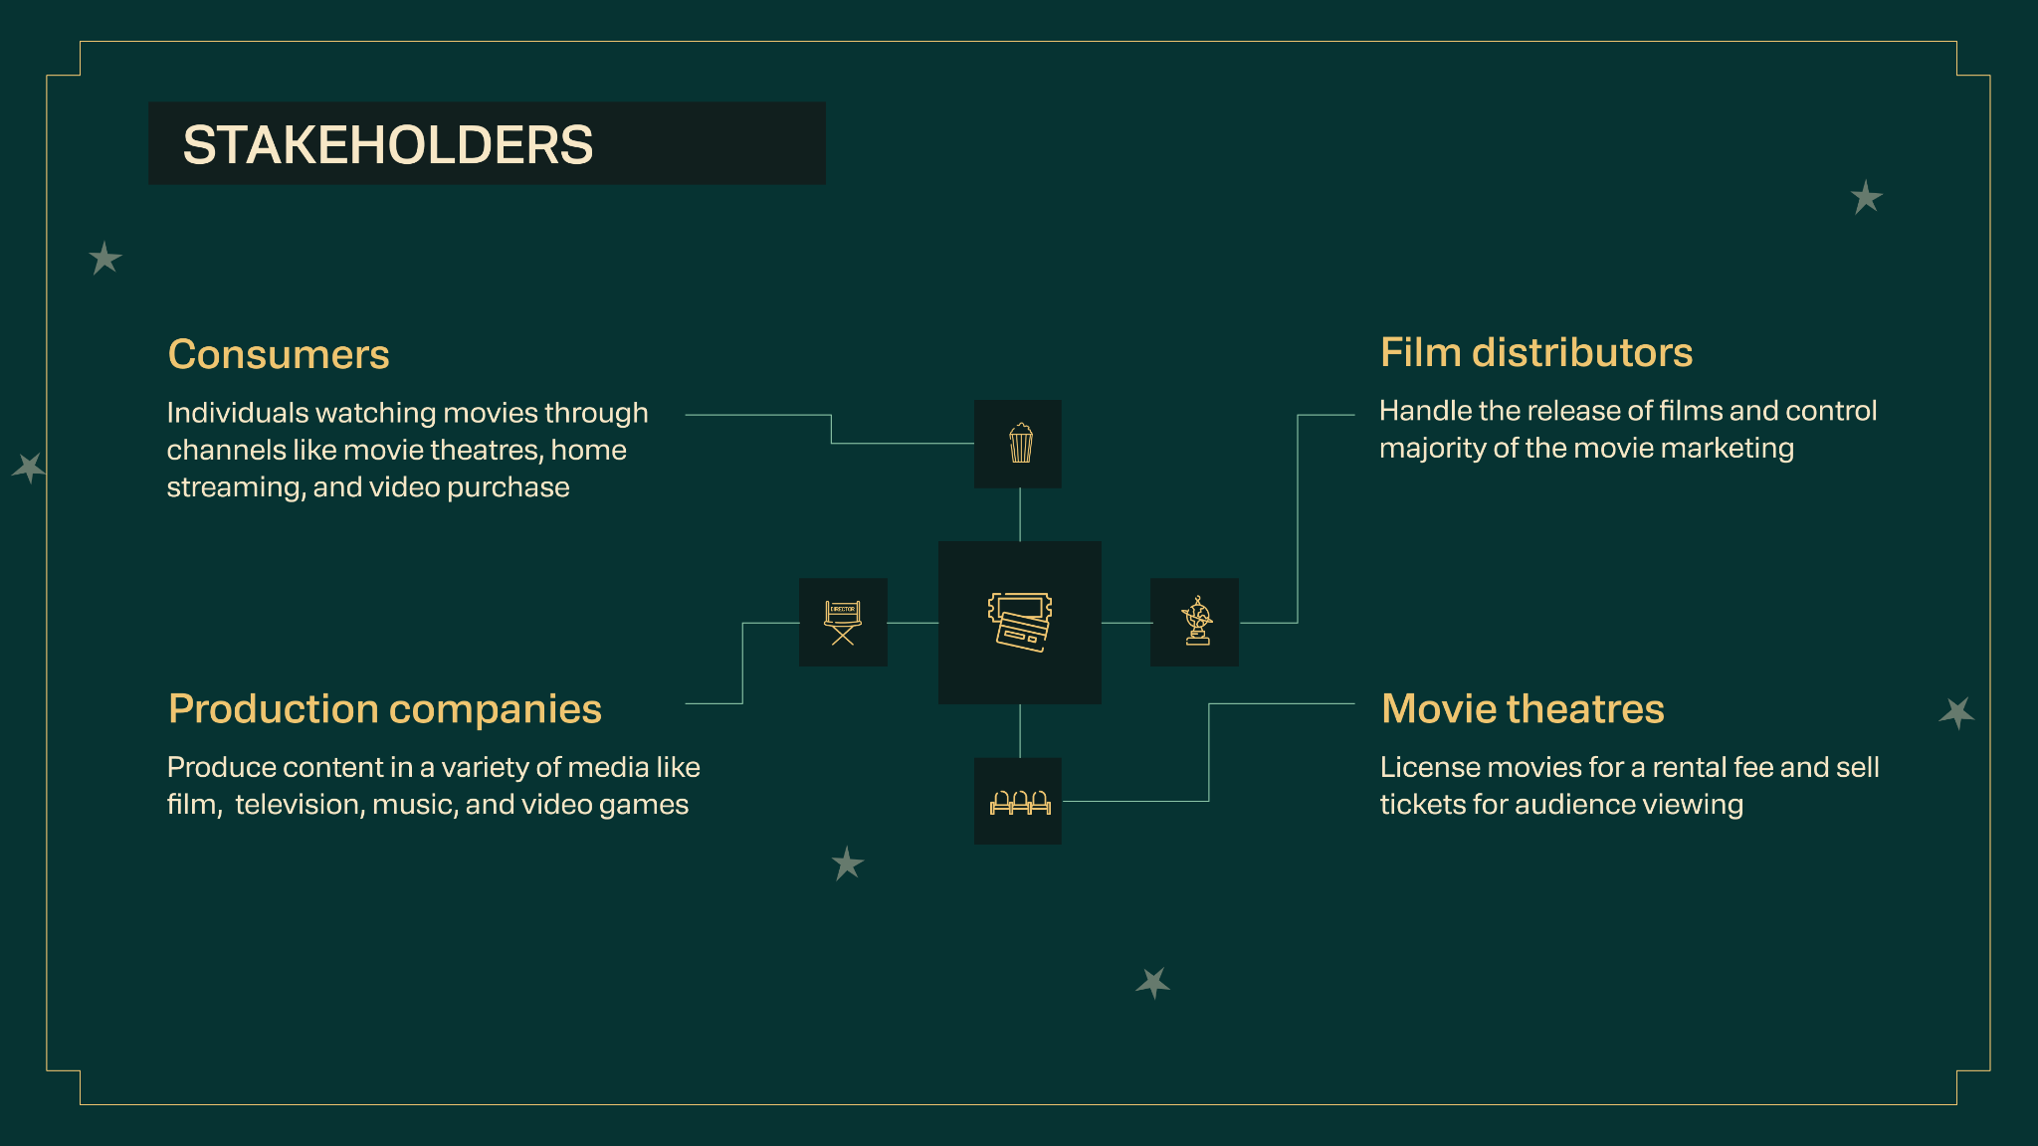

Slide 6
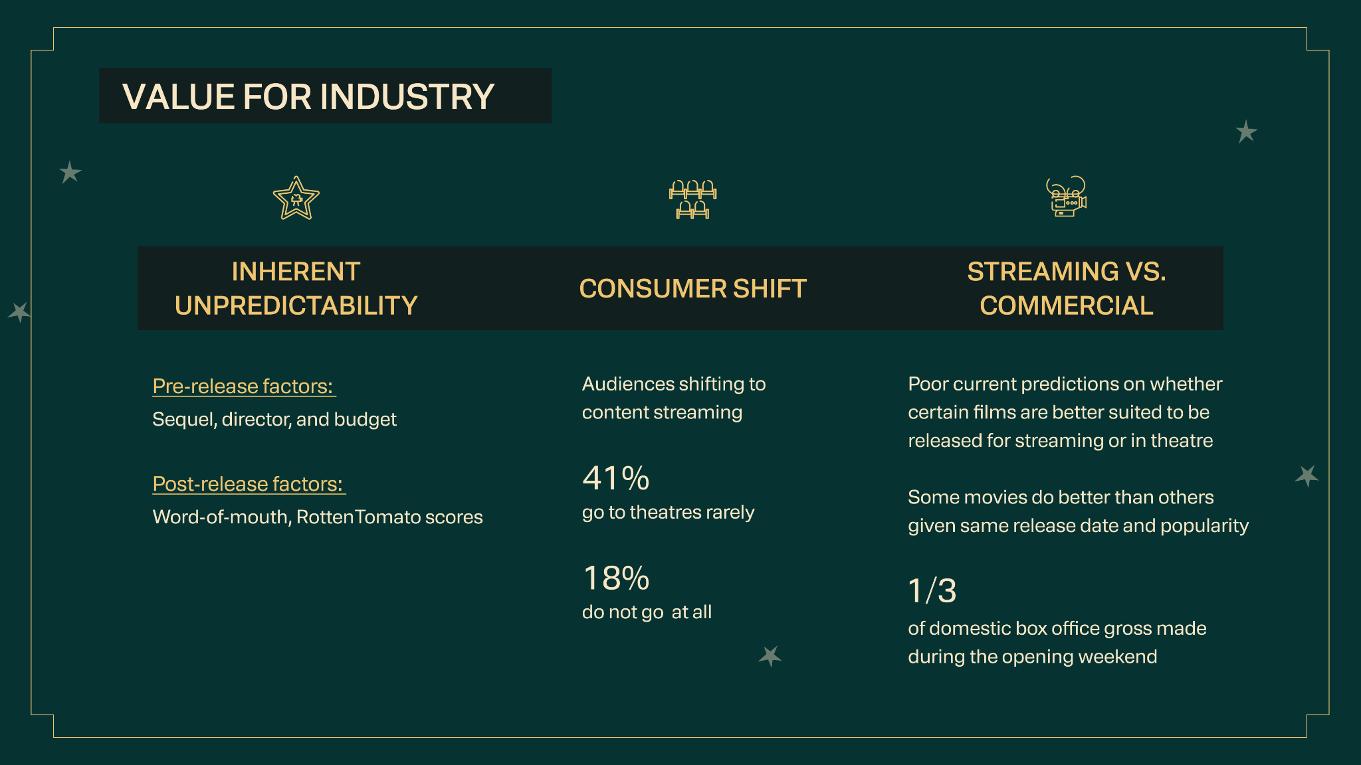

Slide 7
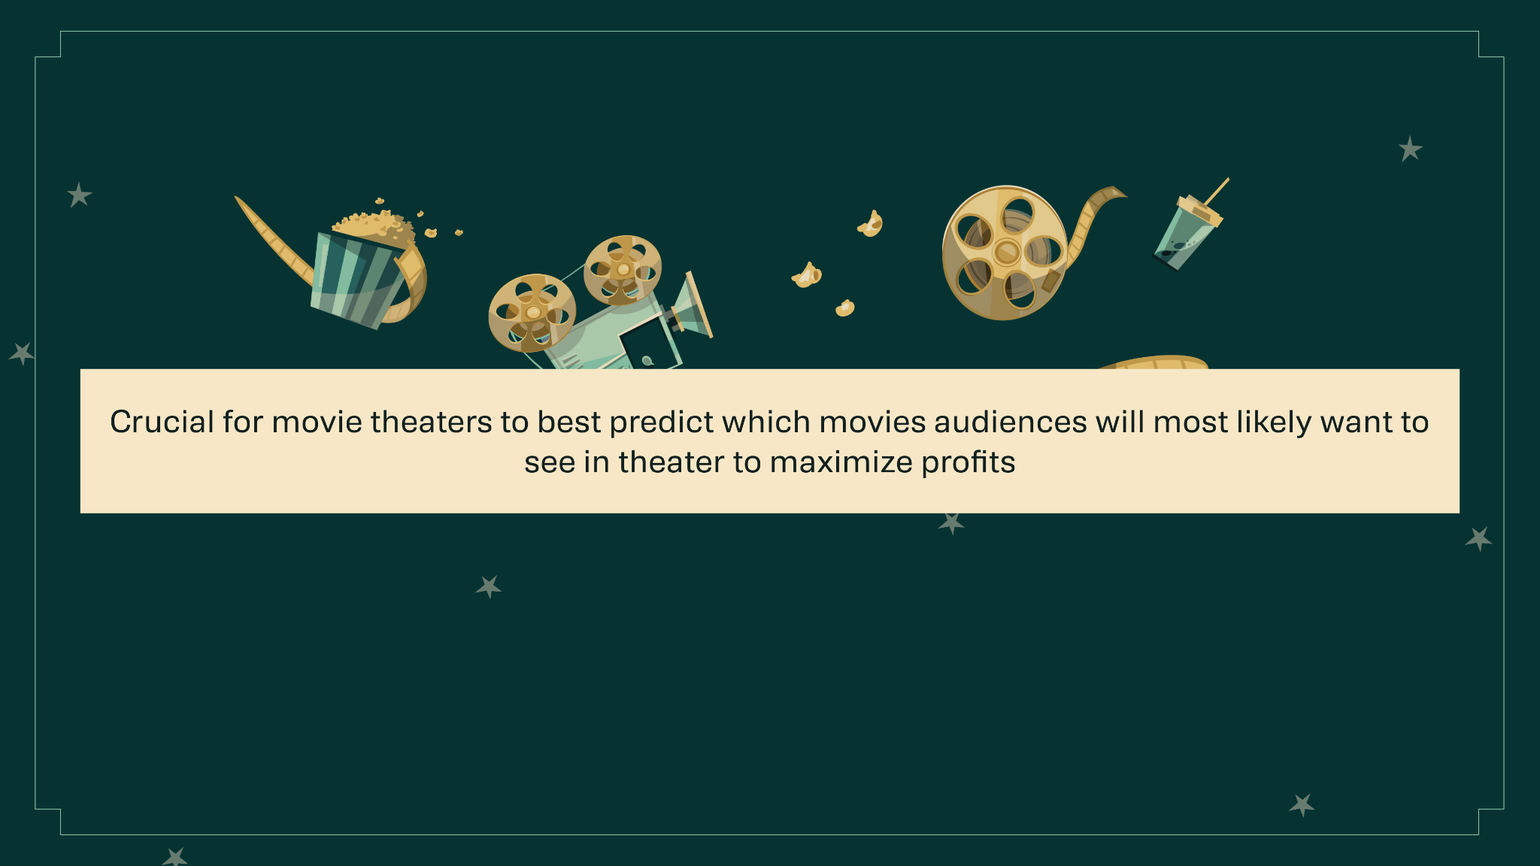

Slide 8
DATASET OVERVIEW
BEFORE
AFTER
IMDB.csv

Slide 9

DATA CLEANING
Data Cleaning – “Total_Gross”
1.
“Total Gross” is what we want to predict:
Indicator of films’ success
But it has missing values!

Slide 10


DATA CLEANING
Data Cleaning – “Total_Gross”
1.
But it is not numerical!

Slide 11

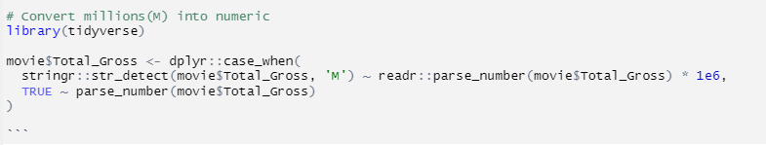
DATA CLEANING
Data Cleaning – “Total_Gross”
1.
“Total_Gross” is clean now!

Slide 12
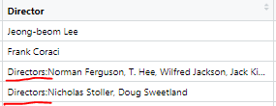
DATA CLEANING
Data Cleaning – “Director”
2.
Inconsistent format!

Slide 13

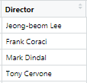
DATA CLEANING
Data Cleaning – “Director”
2.
Remove rows that didn’t start with the Director’s name

Slide 14

DATA CLEANING
Data Cleaning – “Actors”
3.
Multiple Actors
Separated by Commas

Slide 15
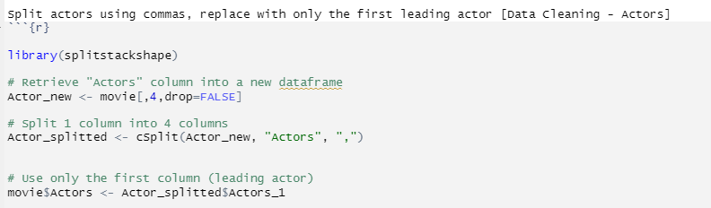
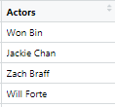
DATA CLEANING
Data Cleaning – “Actors”
3.
Leave only one leading actor

Slide 16
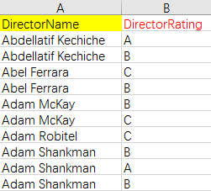
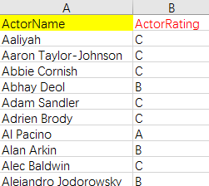
DATA CLEANING
Substitute: director names -> director ratings (A, B, C)
4.
actor names -> actor ratings (A, B, C)
Introduce two more datasets
director.csv
actor.csv

Slide 17
Models
DECISION TREE
RANDOM FOREST
KNN

Slide 18
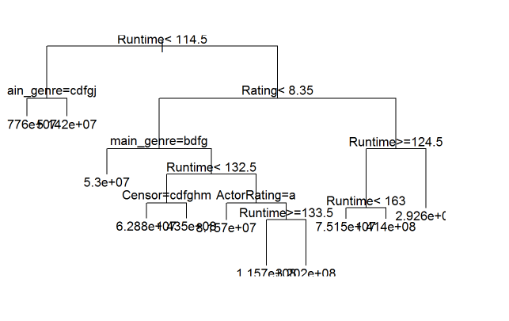
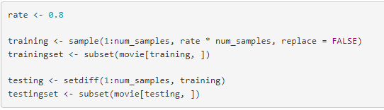
DECISION TREE
RMSE: 51,972,790
Train + model

Slide 19
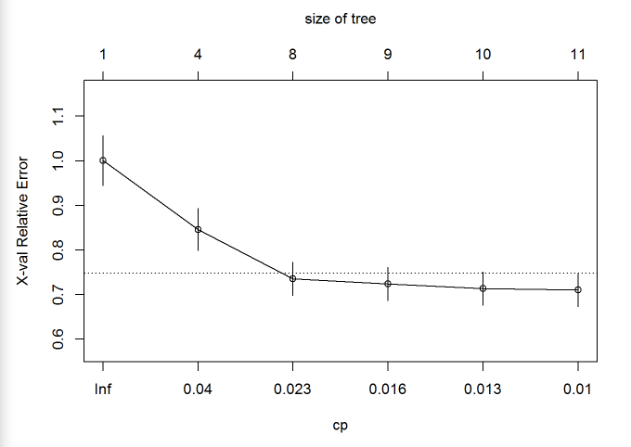
DECISION TREE
RMSE: 51,972,790
2. Find optimal cp
cp ≈ 0.024

Slide 20
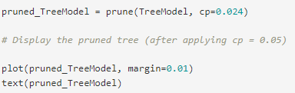
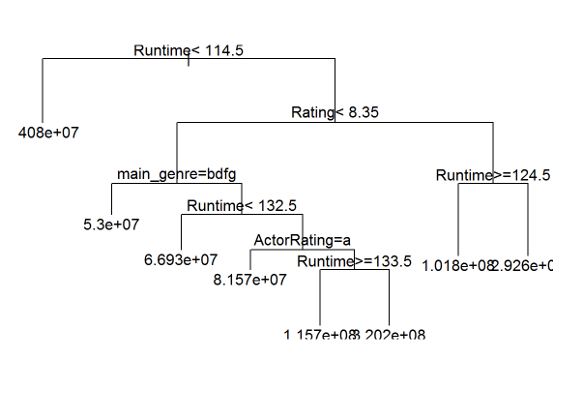
DECISION TREE
RMSE: 51,972,790
3. Prune and test

Slide 21
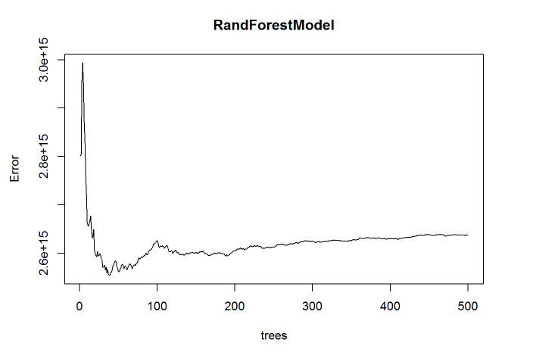
RANDOM FOREST
RMSE: 55,442,910
Train + model

Slide 22
RANDOM FOREST
RMSE: 55,442,910
2. Test

Slide 23
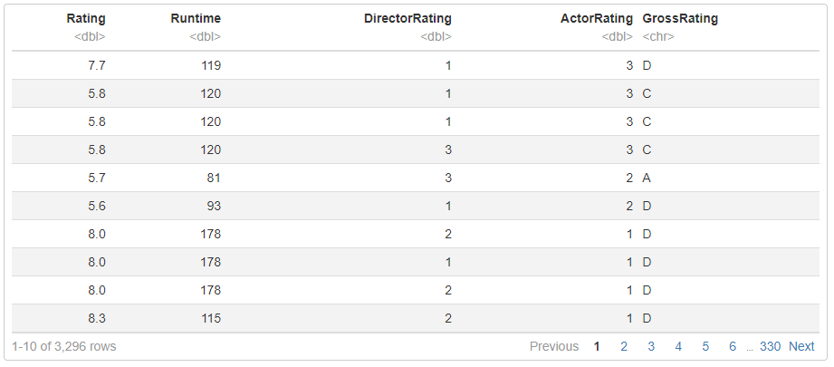
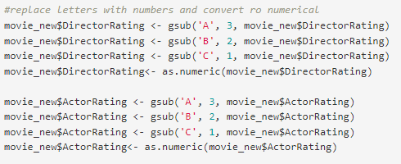
KNN
Misclassification rate: 44.39%
Transform
Make all inputs numerical

Slide 24
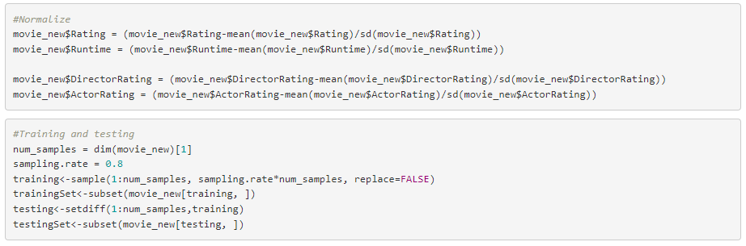
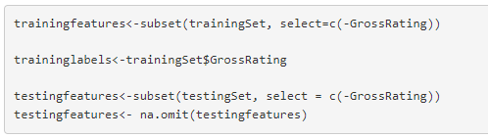
KNN
Misclassification rate: 44.39%
2. Normalize and train

Slide 25
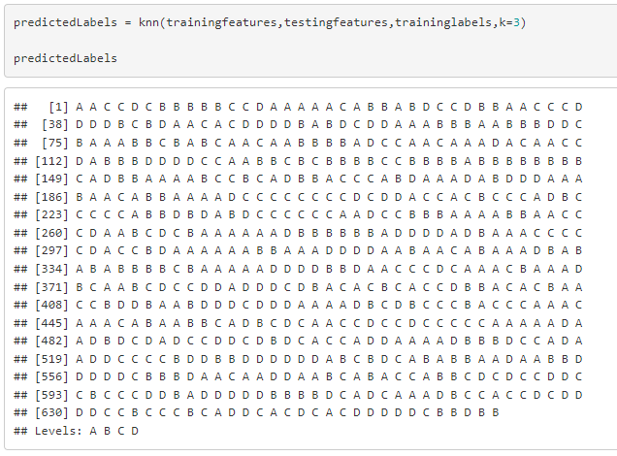
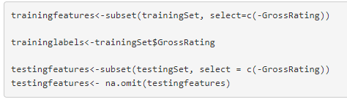
KNN
Misclassification rate: 44.39%
3. Create features and test

Slide 26
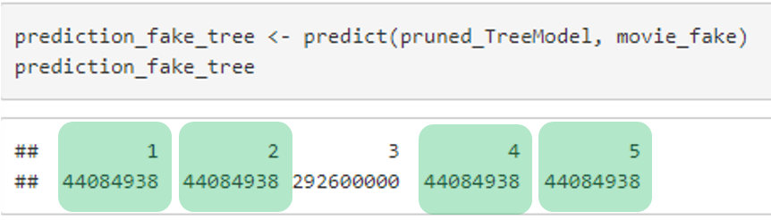
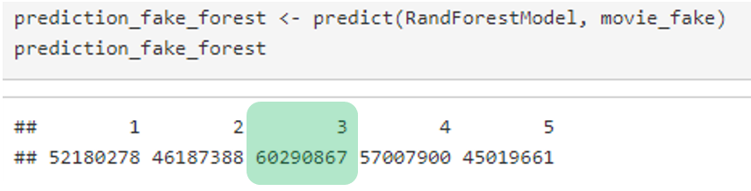
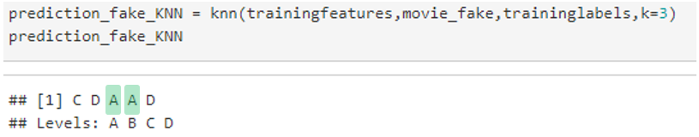
MODEL PREDICTIONS
Decision Tree
Random Forest
KNN
RMSE:
51,972,790
RMSE:
55,442,910
Misclassification Rate: 44.39%

Slide 27
DECISION
Which movie is the right answer?
Both Movie 3 and 4 are predicted as highest grossing in 2 models
However … there is no one right answer, can't forget qualitative factors
Learnings?
How to clean data
How to assess models
How models supplement decision making

Slide 28
FUTURE IMPLEMENTATION
FIRST
SECOND
THIRD
Predict best number of weeks to show a movie
Model for what ticket price to charge consumers based on box office predictions
Predict when the best showtime for the movie is

Slide 29
ETHICAL CONSIDERATIONS
DATASET BIAS
Dataset inputs may already include biases
(Selection Bias)
Marginalization of actors/actress from specific racial backgrounds
Uneven casting and income opportunities

Slide 30
thank you
Any questions?

